Slide 1

Turbolearn: Harnessing Accurate and Line-Rate Deep Learning on Programmable Switches
APNet 2026
Zhifan Jiang, Longlong Zhu, Jiashuo Yu,
Linying Zheng,Chunming Wu, Xiang Chen
Zhejiang University
Notes:
Good afternoon, I’m Zhifan Jiang from Zhejiang University. Today I’ll present the paper of Turbolearn: Harnessing Accurate and Line-Rate Deep Learning on Programmable Switches. This work explores how to achieve both high accuracy and line-rate performance for intelligent data plane inference.

Slide 2



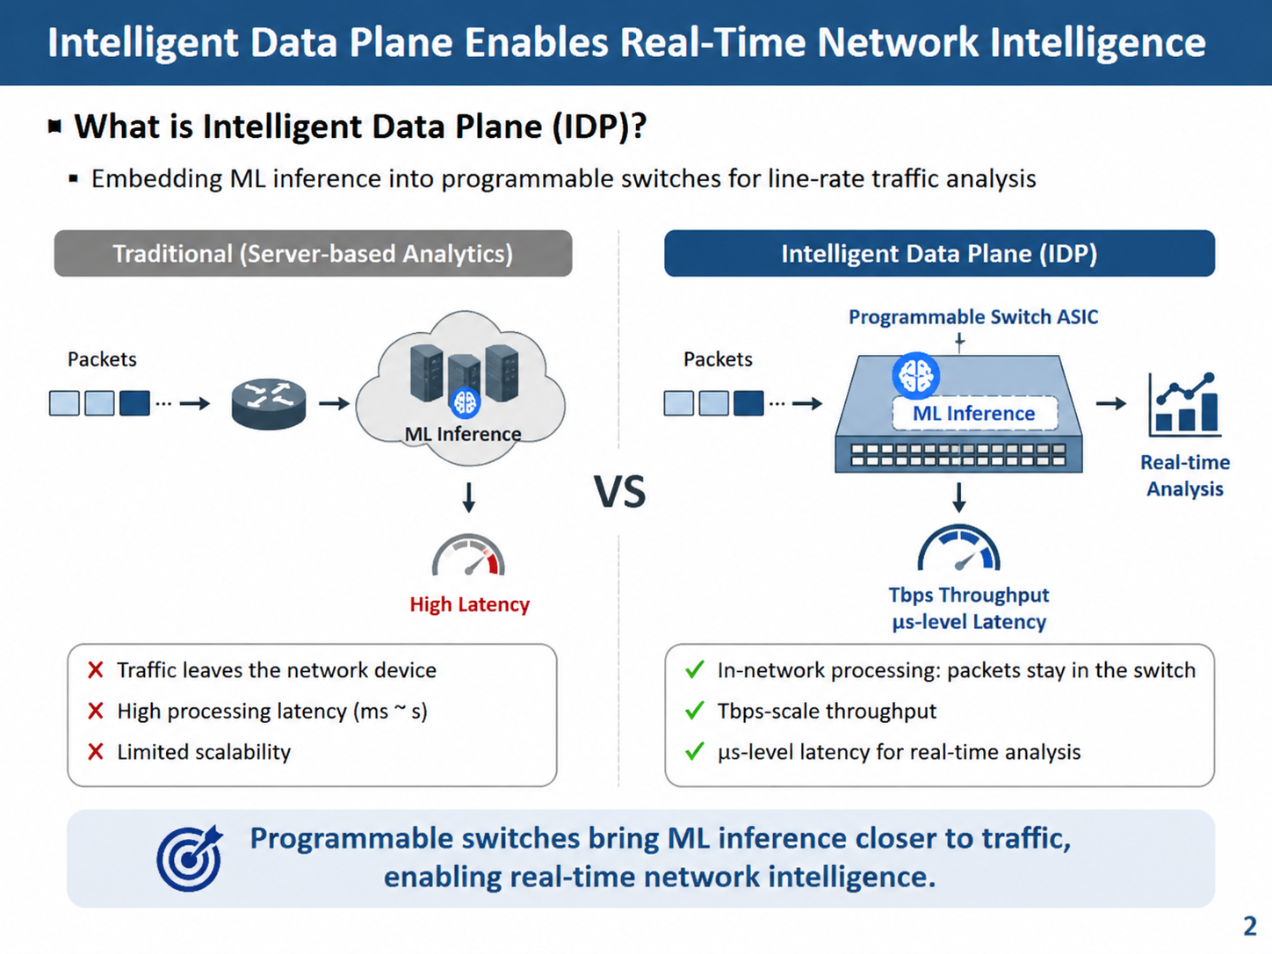
Intelligent Data Plane Enables Real-Time Network Intelligence
What is Intelligent Data Plane (IDP)?
Embedding ML inference into programmable switches for line-rate traffic analysis
Traditional (Server-based Analytics)
Intelligent Data Plane (IDP)
Packets
Switch
ML Inference
Server
Packets
Programmable Switch ASIC
(with ML inference)
High Latency
Tbps Throughput
μs-level Latency
❌ Traffic leaves the network device
❌ High processing latency (ms ~ s)
❌ Limited scalability
✓ In-network processing: packets stay in the switch
✓ Tbps-scale throughput
✓ μs-level latency for real-time analysis
Notes:
Traditionally, network traffic analysis relies on external servers.
Although server-based solutions support complex models, they introduce additional communication overhead and latency.
Intelligent Data Plane, or IDP, moves machine learning inference directly into programmable switches.
By embedding ML inference into switch ASICs, IDP can provide Tbps (terabits per second) throughput and microsecond-level latency.
However, deploying accurate deep learning models directly inside ASICs remains challenging.

Slide 3
Existing IDP Faces an Accuracy–Performance Trade-off
Why do existing IDP systems struggle?
Limited ASIC resources prevent high-capacity ML models from being deployed at line rate.
As a result, existing systems sacrifice accuracy for performance.
Approach | Limitation
N3IC | simplified models
BoS | lookup approximation
Pegasus | ASIC resource bound
ASIC-only inference creates a fundamental conflict between model accuracy and line-rate performance.
This motivates a new architecture beyond purely ASIC-only inference.
Notes:
Existing IDP systems mainly follow ASIC-only designs.
They require the entire inference pipeline to run inside the switch ASIC.
However, ASIC resources are limited, which prevents deploying high-capacity models at line rate.
Therefore, existing approaches have to simplify models or use approximation techniques.
For example, N3IC uses simplified models, BoS uses lookup approximation, and Pegasus is limited by ASIC resources.
As a result, existing systems face a fundamental trade-off between accuracy and performance.

Slide 4

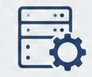
Insight 1: Complementary Computing Resources
Key observation:
Observation 1: The switch has two computing resources
ASIC Pipeline
Switch OS
Line-rate
Low latency
Limited computation
Complex models
High accuracy
Higher latency
The two resources provide complementary advantages.
This creates the opportunity for split inference.
Notes:
Our first observation is that a programmable switch provides two complementary computing resources.
The ASIC pipeline provides:line-rate processing,low latency,but has limited computation capability.
On the other hand, the Switch OS supports complex models and higher accuracy, but introduces higher latency.
Therefore, these two resources provide complementary advantages. This creates the opportunity for split inference.

Slide 5
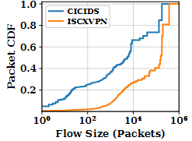
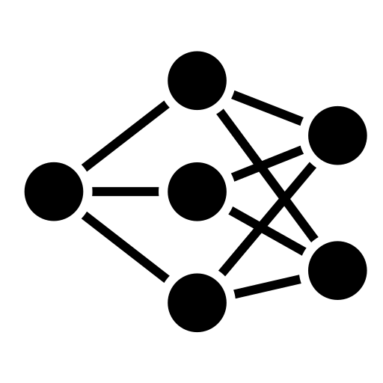

Insight 2: Traffic Difficulty is Uneven
Key observation:
Observation 2: Most traffic is easy, while only a small fraction is hard.
Easy flows
Light Model
(e.g., CNN)
Hard flows
Complex Model (e.g., Transformer)
Most flows are easy and can be handled by a lightweight model, while only a small fraction require accurate inference.
This motivates processing easy flows in ASIC and escalating only hard flows to software.
Notes:
Our second observation is that traffic difficulty is uneven.
Not all flows require complex inference.
Most flows are easy and can be handled by lightweight models, such as CNN.
Only a small fraction of hard flows require more accurate models, such as Transformer.
Therefore, we can keep easy traffic inside the ASIC and send only difficult traffic to software.

Slide 6



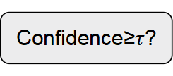
Turbolearn Overview
Normal Path (Switch OS)
Digest
Flow State
Update
Accurate Inference
Digest Poller
Fast Path (Switch ASICs)
PCIe Channel
Flow Classification Table
Packets
5-tuple
Labels
(10.1.2.3,···
bengin
Cache Hit
(17.2.1.4,···
malicious
Flow
······
······
Output
Yes
Classification
Results
Cache Miss
Packet Features
Confidence≥$τ$?
Flow
Features
Lightweight
Model
Digest
Generation
No
Notes:
Based on these observations, we propose Turbolearn.
Turbolearn introduces a two-path architecture.
The fast path runs inside the switch ASIC and handles common cases using lightweight models.
The normal path runs on the Switch OS and handles uncertain flows using accurate models.
After software inference, the result updates the flow table.
Therefore, future packets from the same flow can be processed entirely by the fast path.
The key idea is:we only pay the software inference cost for uncertain flows.

Slide 7


Fast Path: Line-rate ASIC Inference
Processes most flows at line rate with lightweight inference
ASIC-friendly lookup
aggregation
Feature Extraction
Confidence Estimation
Score: $0.95$
$$≥τ$$
“Benign”
Packet
Light Model
$$τ=0.9$$
packet features
flow state
High (≥ τ) → Output
Low (< τ) → Digest
Key Insight: Fast path handles the common cases at line rate, and only uncertain flows are escalated to software.
Notes:
The fast path performs three steps.
First, it extracts packet features and flow states.
Second, it performs lightweight inference using ASIC-friendly operations such as lookup and aggregation.
Third, it estimates the confidence of the prediction.
If the confidence is higher than the threshold, the switch directly outputs the result.
Otherwise, it generates a digest and sends the flow to the normal path.

Slide 8



Normal Path: Accurate Software Inference
Handles only low-confidence flows with complex models
Feature Extraction
Score: $0.72$
$$<τ$$
Packet
(Unknown)
Light Model (e.g., CNN)
$$τ=0.9$$
Digest
Generator
PCIe
Digest
Receiver
Update Flow Table
“Malicious”
Switch ASIC
Switch OS
Complex Model (e.g., Transformer)
[Flow ID: Malicious]
Key Insight: Only uncertain flows are sent to software, and flow table updates eliminate repeated inference.
Notes:
The normal path handles uncertain flows.
When a flow has low confidence, the ASIC generates a digest and sends it to the Switch OS through PCIe.
The software side runs a more accurate model, such as Transformer.
After obtaining the final prediction, it updates the flow table.
This allows future packets to stay in the fast path without repeated software inference.

Slide 9
Experimental Setup
Hardware Platform:
Intel Tofino2 programmable switch with 32 × 400Gbps ports, supporting ASIC fast path and Switch OS normal path.
Network Intelligence Workloads:
Encrypted traffic classification (ISCXVPN), P2P detection (PeerRush), and intrusion detection (CICIDS).
Baselines:
ASIC-only approaches: N3IC, BoS, and Pegasus
Software-based approach: OS-Only
Models:
Fast path: ASIC-friendly models (CNN-S by default).
Normal path: high-capacity software models (Transformer-S by default).
Threshold: τ = 0.9.
Notes:
We evaluate Turbolearn on a real programmable switch platform.
Our testbed uses Intel Tofino2 with thirty-two times four hundred gigabits per second ports.
We evaluate three workloads:
ISCXVPN for encrypted traffic classification,
PeerRush for P2P traffic detection,
and CICIDS for intrusion detection.
We compare with N3IC, BoS, Pegasus, and OS-Only.
For Turbolearn, we use CNN-S on the fast path and Transformer-S on the normal path with tau equals zero point nine.

Slide 10
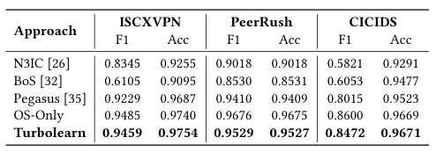
Experiment 1: Accuracy Improvement
Improves Macro-F1 by 1.3–54.9% over ASIC-only designs → leveraging accurate software models for hard flows
Maintains near software-level accuracy → avoiding full software inference for all traffic
Achieves accuracy close to OS-Only
Notes:
First, we evaluate classification accuracy.
Compared with ASIC-only approaches, Turbolearn improves Macro-F1 by up to fifty-four point nine percent.
This improvement comes from using accurate software models for difficult flows.
At the same time, Turbolearn achieves accuracy close to OS-Only, without running software inference for all traffic.
Therefore, Turbolearn can recover software-level accuracy while maintaining efficient processing.

Slide 11
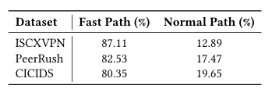
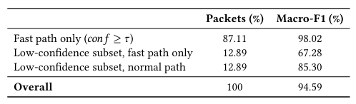
Experiment 2: Effective Traffic Selection
Keeps 80–87% traffic on the fast path → lightweight ASIC models handle most easy flows
Improves low-confidence flow accuracy from 67.3% to 85.3% → normal path recovers hard cases with accurate models
Most traffic remains in ASIC
Notes:
Next, we evaluate whether Turbolearn can effectively select difficult flows.
The results show that most traffic remains in the fast path.
For ISCXVPN, the fast-path ratio reaches eighty-seven point one one percent.
For PeerRush, it reaches eighty-two point five three percent.
For CICIDS, it reaches eighty point three five percent.
Only a small fraction of uncertain flows are escalated to the normal path.
This significantly reduces the software inference workload.

Slide 12
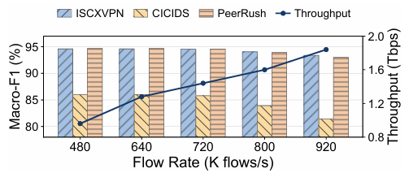
Experiment 3: Line-rate Performance
Maintains Tbps-level throughput → fast path remains entirely inside the ASIC pipeline
Achieves 1.37 μs fast-path latency → software inference (~1.334 ms) is only triggered for uncertain flows
High throughput with stable accuracy
Notes:
Finally, we evaluate performance under different traffic rates.
Turbolearn maintains high throughput because most traffic stays inside the ASIC fast path.
The fast path achieves one point three seven microseconds latency.
Meanwhile, only uncertain flows require software processing.
Therefore, Turbolearn achieves both high accuracy and line-rate performance.

Slide 13
Conclusion
Existing intelligent data plane approaches cannot simultaneously achieve high accuracy and line-rate performance
Turbolearn: Split Inference for Intelligent Data Planes:
  A dual-path architecture combining ASIC fast path for lightweight inference and witch Switch OS normal path for accurate models
  Confidence-based traffic steering that sends only uncertain flows to software inference
  Flow-aware model update mechanism to avoid repeated software processing
Results: Compared with existing ASIC-only approaches, Turbolearn improves Macro-F1 by up to 54.9% while maintaining line-rate throughput and μs-level latency
Thank you!
Notes:
To conclude,
Existing IDP systems face a fundamental conflict between accuracy and performance.
We propose Turbolearn, a split inference framework that combines:
ASIC fast path for line-rate processing,
Switch OS normal path for accurate inference,
confidence-based traffic selection.
Our evaluation shows that Turbolearn improves Macro-F1 by up to fifty-four point nine percent while maintaining line-rate throughput.
Thank you for your attention.

